Slide 1
LIGHT DESIGN
Technical Theatre

Slide 2
LIGHT DESIGN
Purpose of Light Design:
to engage the audience through the use of
Color
Texture
Mood
Energy
Cell Block Tango” – Chicago
http://youtu.be/KA6R1DMb-Z8
Light directs an audience’s FOCUS
Lights allow the actors, action and artistic elements to be seen
Used for more than practical lighting.
Est. setting and mood
Est. emotional energy of characters

Slide 3
ESSENTIAL QUESTIONS
What precautions are necessary to insure the safety of the performers?
How do the elements of Lighting Design work together to realize the director’s vision?

Slide 4
LIGHT DESIGN
FUNCTIONS OF STAGE LIGHT
Visibility: light so aud can see actors, set, props, etc.
Selective Focus: directing aud’s attention to look at a specific area/character on stage
Modeling: using texture to emphasize the highlight or shadows of things, as to make “it” look real
Mood: use of color to determine time of day or to emphasize emotional context of script/characters
Style: realistic vs. nonrealistic
Information: est. location, time, space

Slide 5
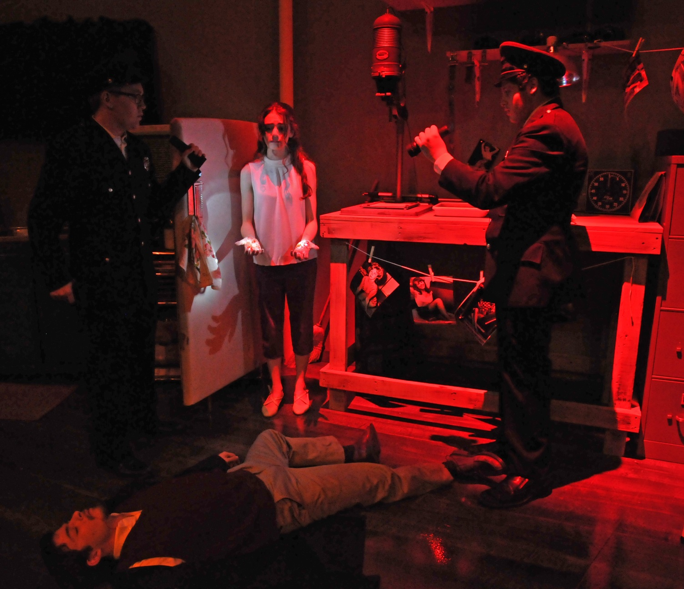
SELECTIVE FOCUS
Wait Until Dark
As the cops found Susie in the corner of the room, she stood up showing her hands, each bloody from the stabbing.
The cops shine their flashlights on her hands to help focus the audiences’ attention there.

Slide 6
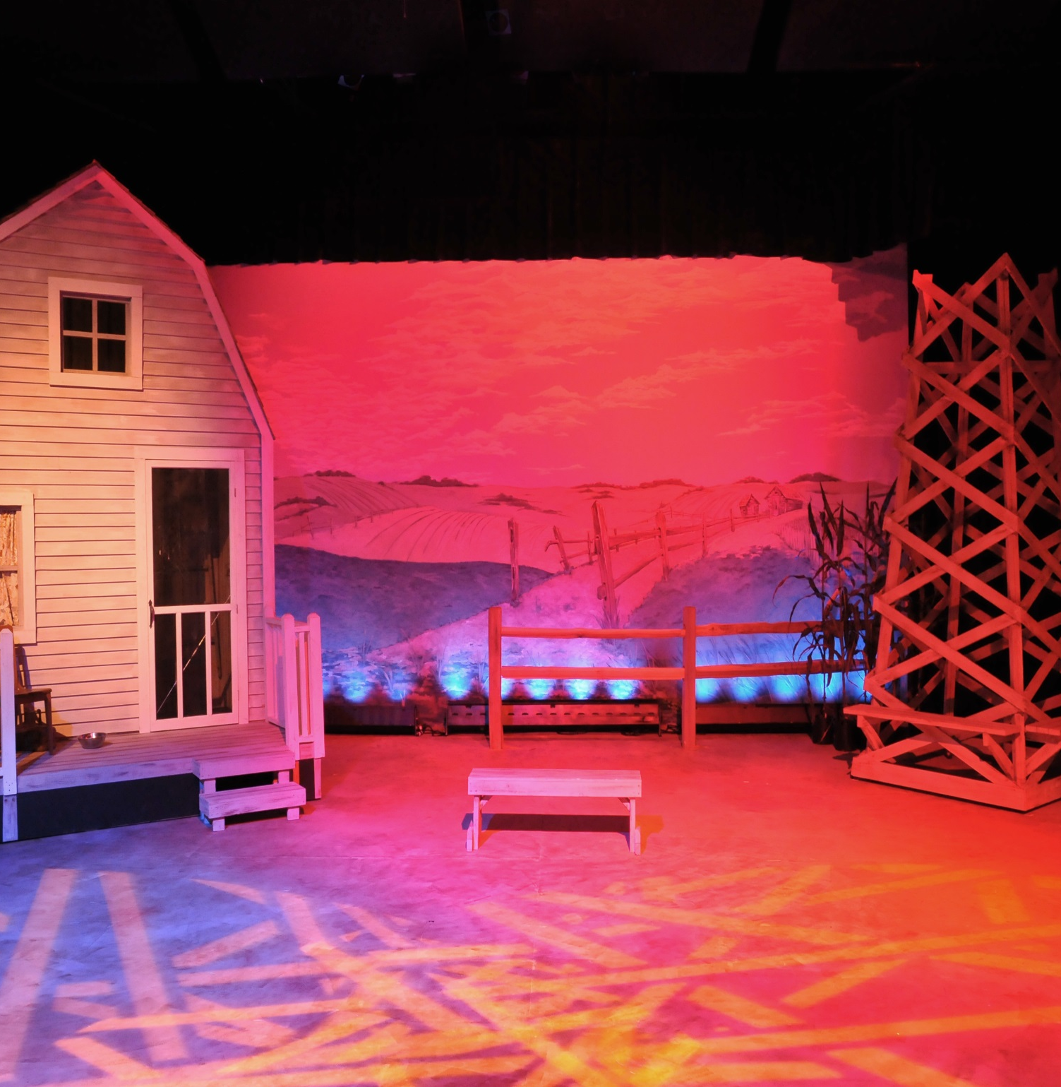
MODELING
Using a stick gobo pattern to resemble the feel of hay/straw in the field.

Slide 7
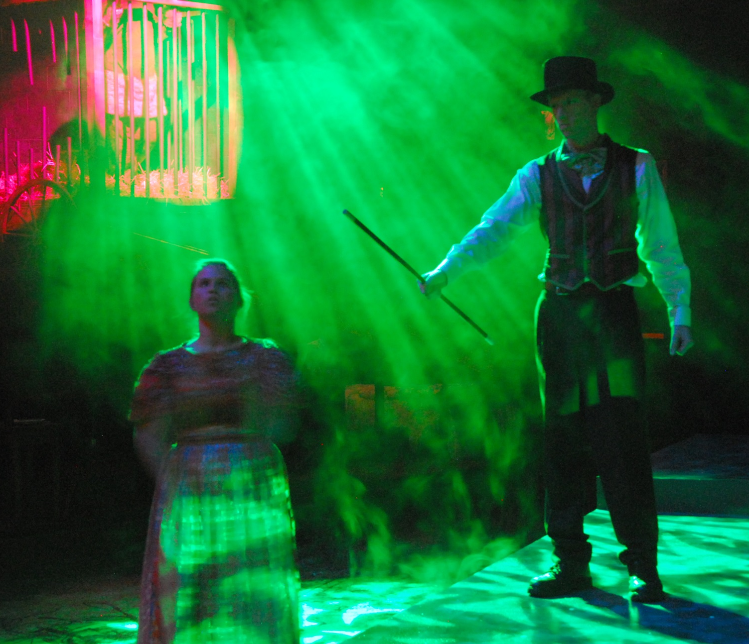
MODELING, MOOD, STYLE
The Elephant Man
MODELING : using shadow to purposely emphasize the hidden desires and the frightening freaks
MOOD: over stimulating with colored light, multiple light sources, multiple gobo patterns
STYLE : non-realistic; green light, chaotic patterns

Slide 8
LIGHT DESIGN
CONTROLABLE QUALTIES OF LIGHT
Distribution: direction of light (light source), size, shape, quality
Intensity: level of brightness
Movement: timed cues, onstage/offstage lights; practicals, light source
Color: determined by gel color & intensity

Slide 9
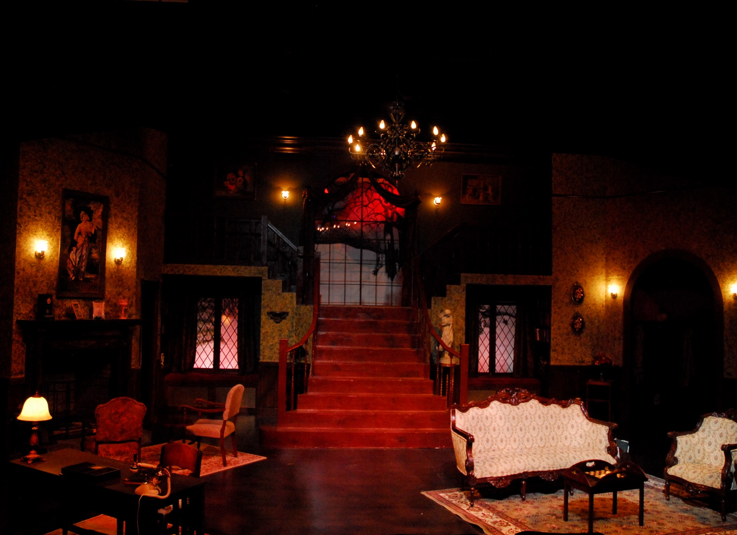
PRACTICALS
The Mousetrap
The use of practicals in this set gives this murder mystery the ominous feel it needs, plus establishes the very real interior set these character will occupy, as they turn lights on and off lights upon entering and exiting.

Slide 10
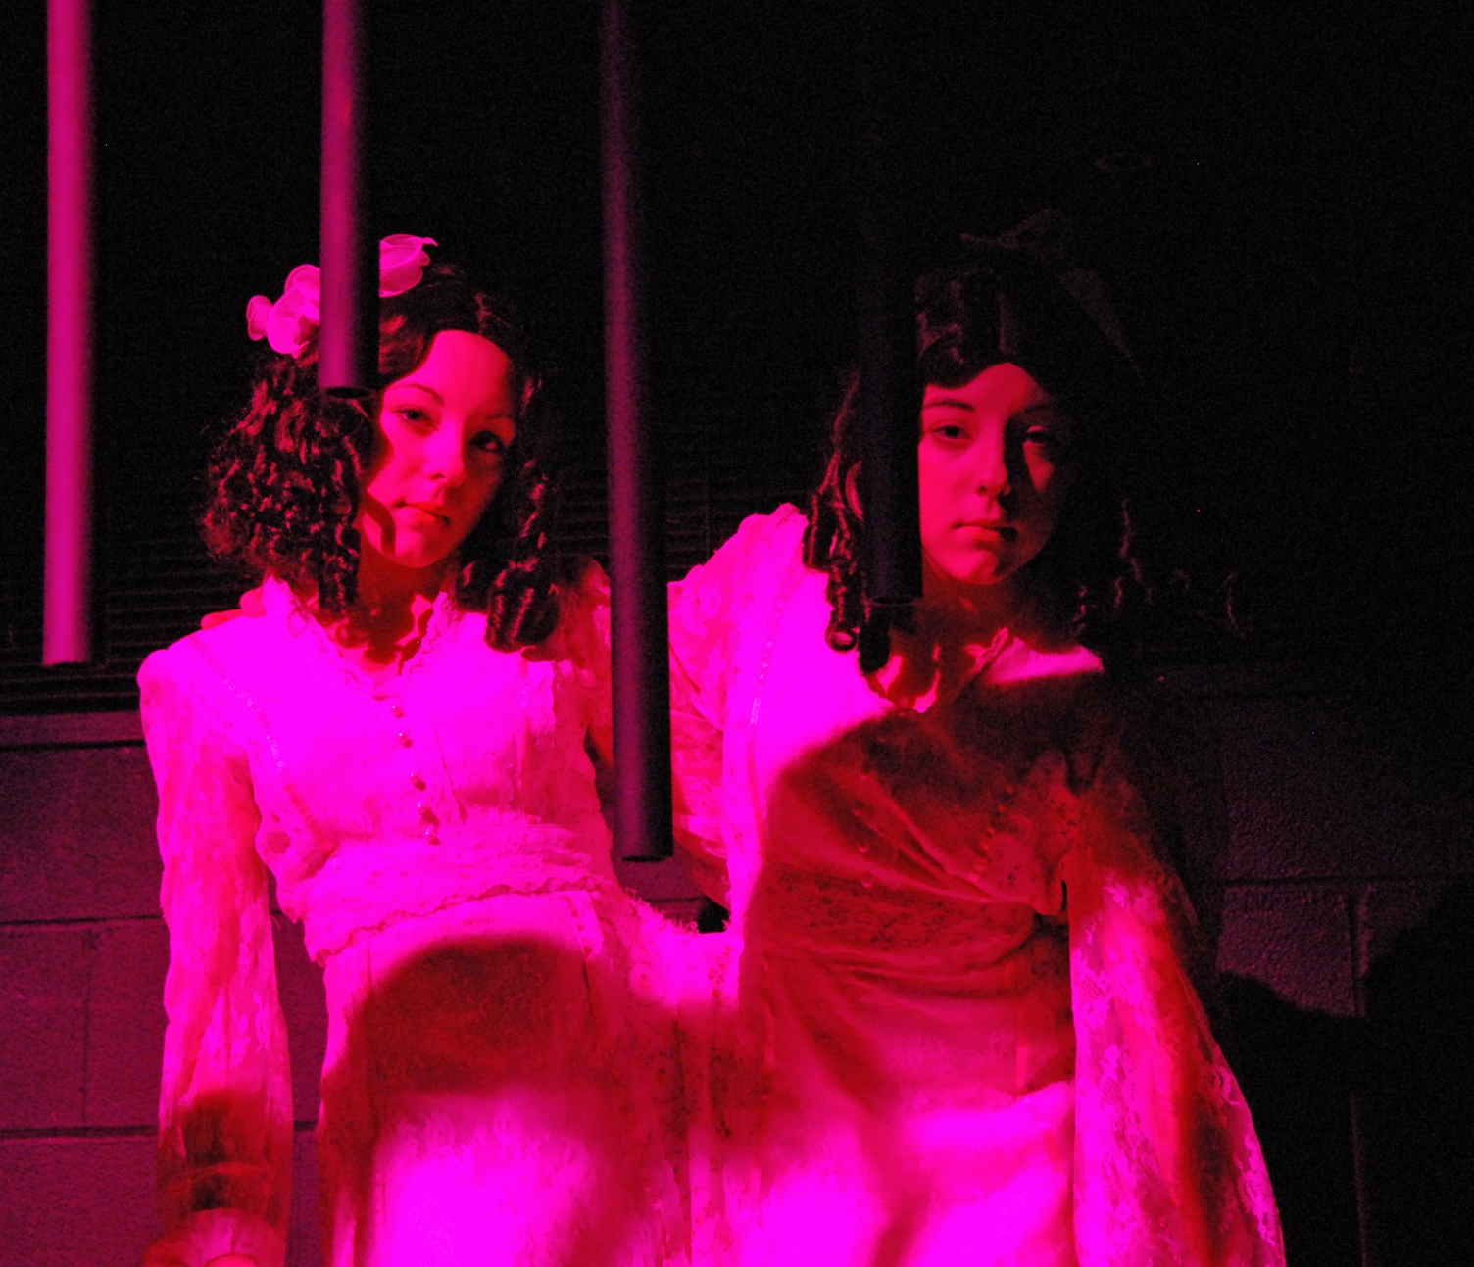
COLOR
The Elephant Man
A dim fuchsia gel color on the Siamese twins, gives these girls the eerie feel the director was looking for as they stood there looking out at the audience in their freak show cage.

Slide 11
LIGHT SAFETY
Keep equipment in good working order
No food or drink near light board
Use dust cover on light board
Never touch the lamp with fingers
Always wear gloves when focusing
Wear closed toed, rubber shoes
Report wet or damp conditions
Know where the fire extinguishers are

Slide 12
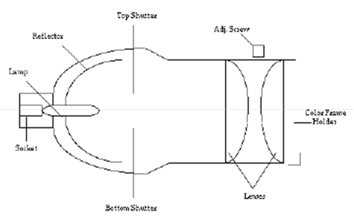
LIGHT FIXTURES
ELLIPSOIDAL REFLECTOR SPOTLIGHT (ERS)
Sizes: 6 x 9, 6 x 12, 6 x 16 (6=lens; 9/12/16 =focal pt)
Focused light
Best for front light
Throw = long distances
650W - 1000W
(2) Plano-convex lens = )(
bench focusing on back
Use shutters for added focusing
Used for “specials”

Slide 13
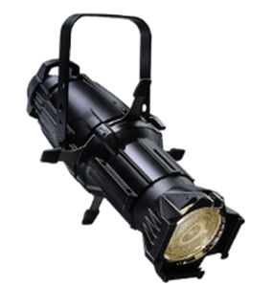
LIGHT FIXTURES
SOURCE FOUR
SIZES: 5’, 10’, 14’, 19’, 26’, 36’, 50’, 70
Directional spotlight
THROW: long and short distance
LAMP: 375-750 watts
575 watt HPL equal to a 1000w lamp yet outperforms the length
FOCUSING: lamp focus, rotating barrel & shutter
OTHER: Gobo and Accessories Slots
Cast Aluminum Construction with bulb in back of fixture = heat escapes out the back = SAFER

Slide 14
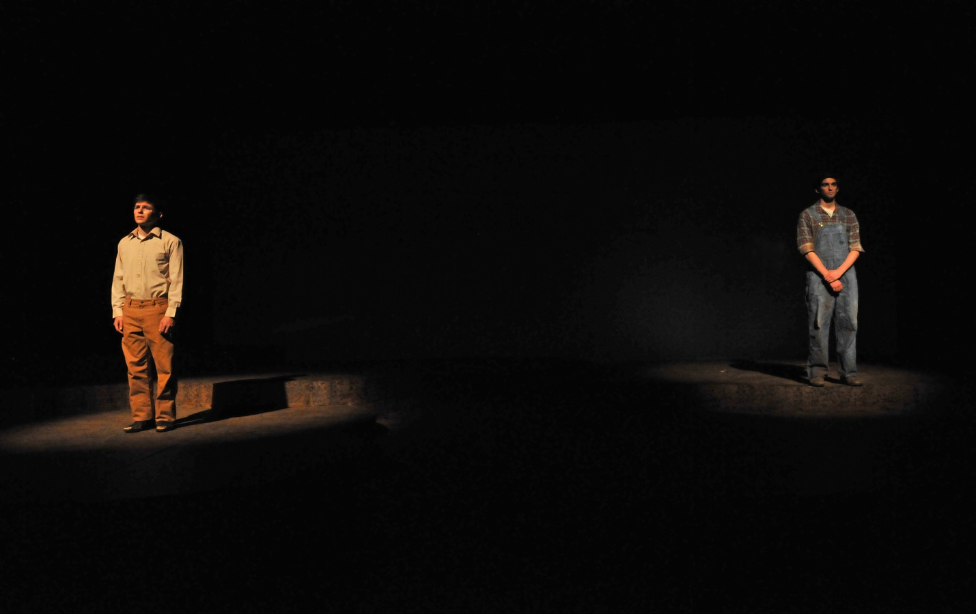
The Diviners – unfocused “specials”

Slide 15
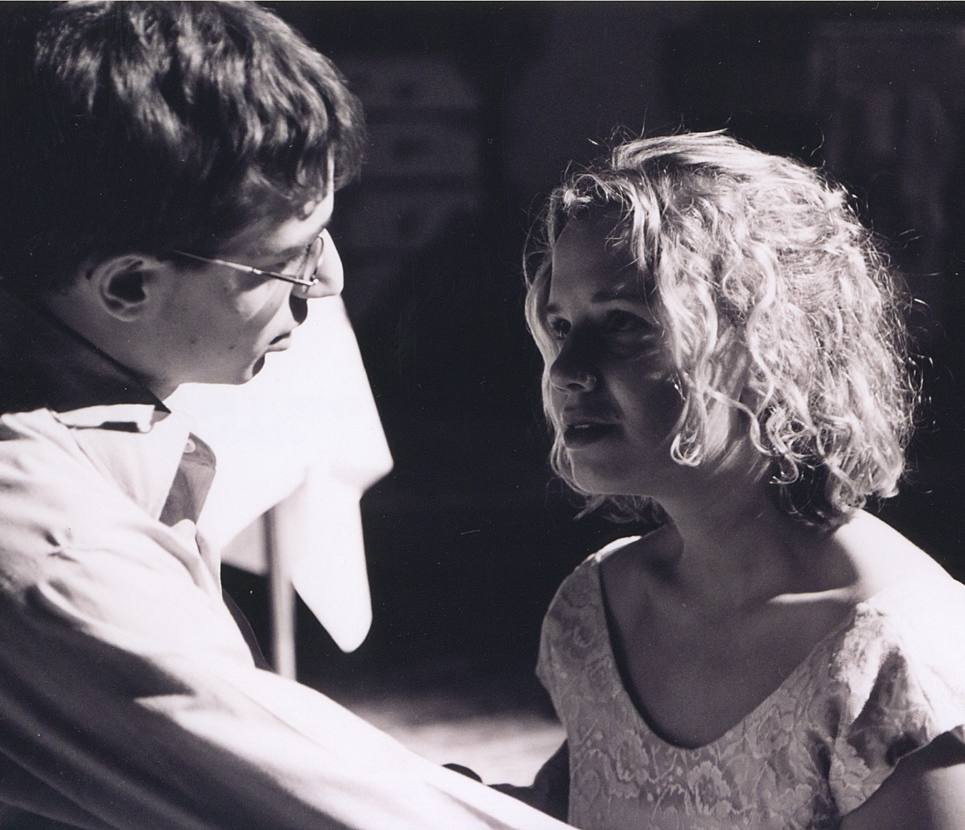
SPECIALS
The House of Blue Leaves
General Lighting was used in this show, however, at the end, the lights slowly faded out except for one SPECIAL that was left on the two here. The final moment of the play just before she dies in his arms.

Slide 16
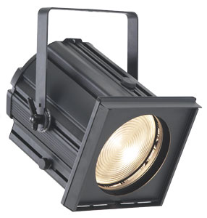
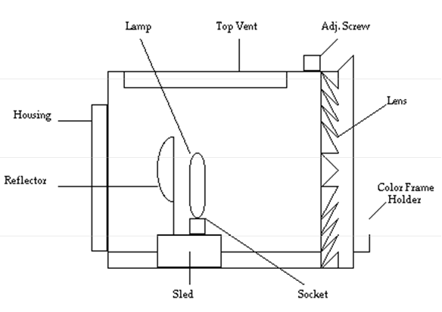
LIGHT FIXTURES
FRESNEL
Sizes: 6”, 10”, 12”
= (diameter of lens)
Soft Light (general)
Best for front (fill light) and back light
Throw = short distance only

Slide 17
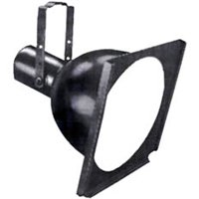
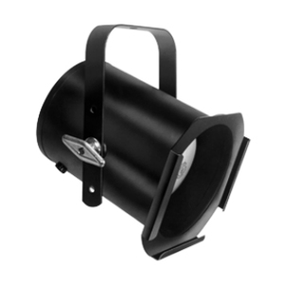
LIGHT FIXTURES
SCOOP
SIZE: 10” 14” 16” 18”
PURPOSE: multi-purpose reflector floodlight
Used in theatre and TV as a flood light where space limitation is a factor.
Ideal for set hallways and window backings where color blending and smooth even washes of light are required.
PAR CAN
Fill light – best for “filling” a space with light
Non directional
Can be gelled

Slide 18
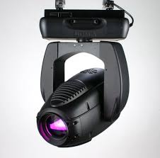
LIGHT FIXTURES
INTELLIGENT LIGHTING
(automated lighting, moving lights, moving heads)
Lights that are automated or have mechanical abilities
“Intelligence” really lies with the programmer/operator of the show rather than the instruments
http://youtu.be/yCByNEigEJM
http://youtu.be/TLOFI-uII3w

Slide 19
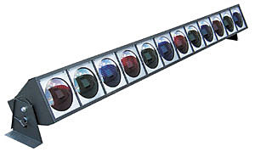
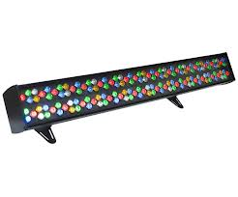
LIGHT FIXTURES
STRIP LIGHT
3 or 5 circuit lights which projects different colors individually or together
Stationary or hung
LED STRIPS
Cyc wash with 144 calibrated red, green, blue, white and amber LEDs
Covers long throws smoothly and evenly.

Slide 20
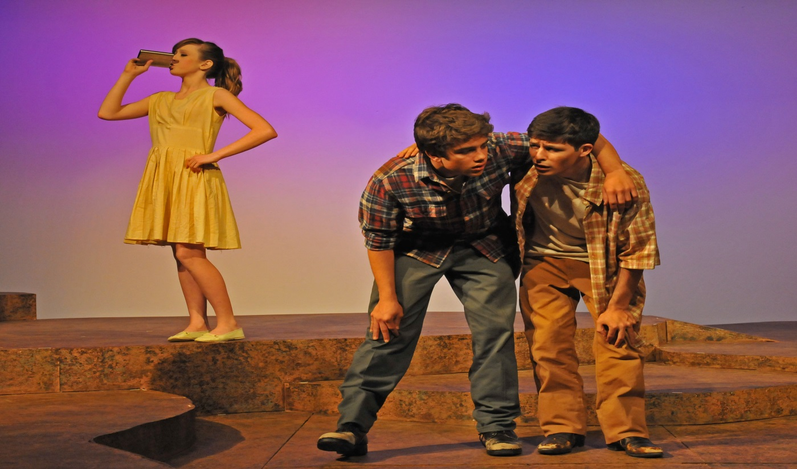
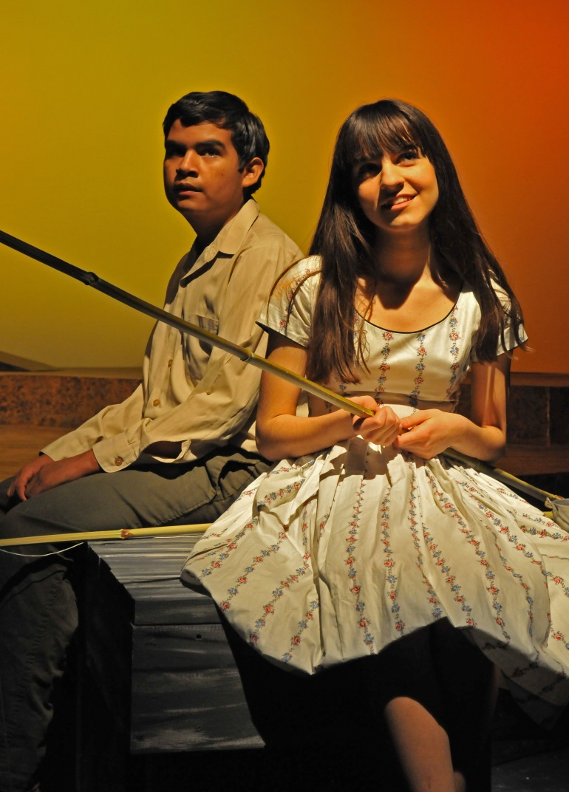
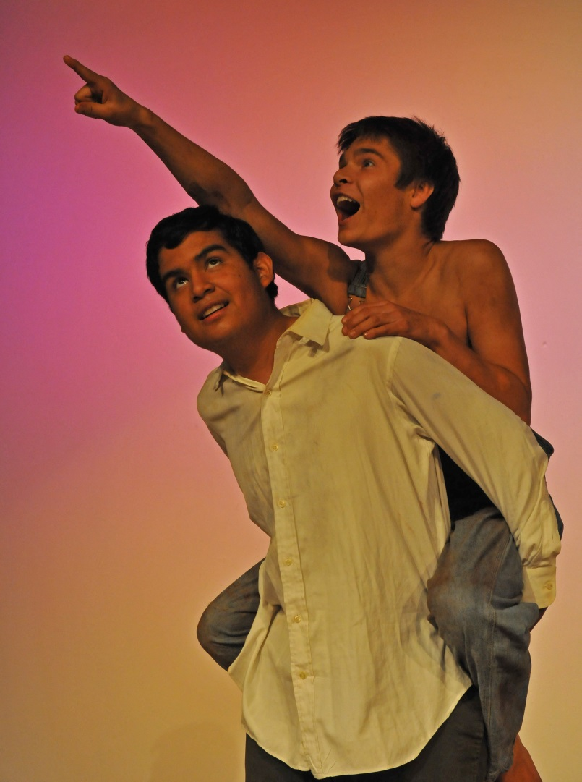
The Diviners – LED Cyc Lights

Slide 21
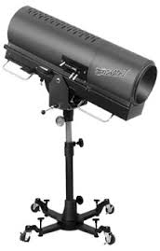
LIGHT FIXTURES
FOLLOW SPOT
Used where manual control of an intense lighting beam is required to “follow” a performer
Vary beam size, quality, and color
Used a lot in musicals to
“follow” the lead singer

Slide 22


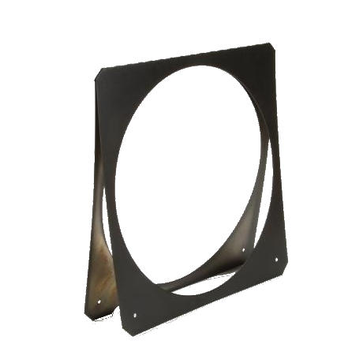
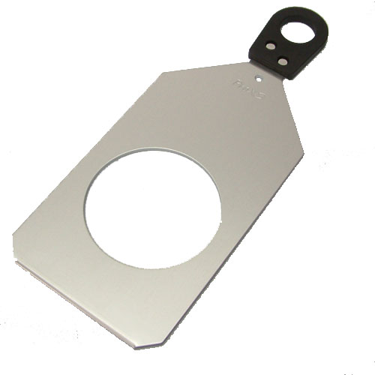
LIGHT ACCESSORIES
GOBO
GOBO
HOLDER
COLOR GEL
GEL FRAME

Slide 23
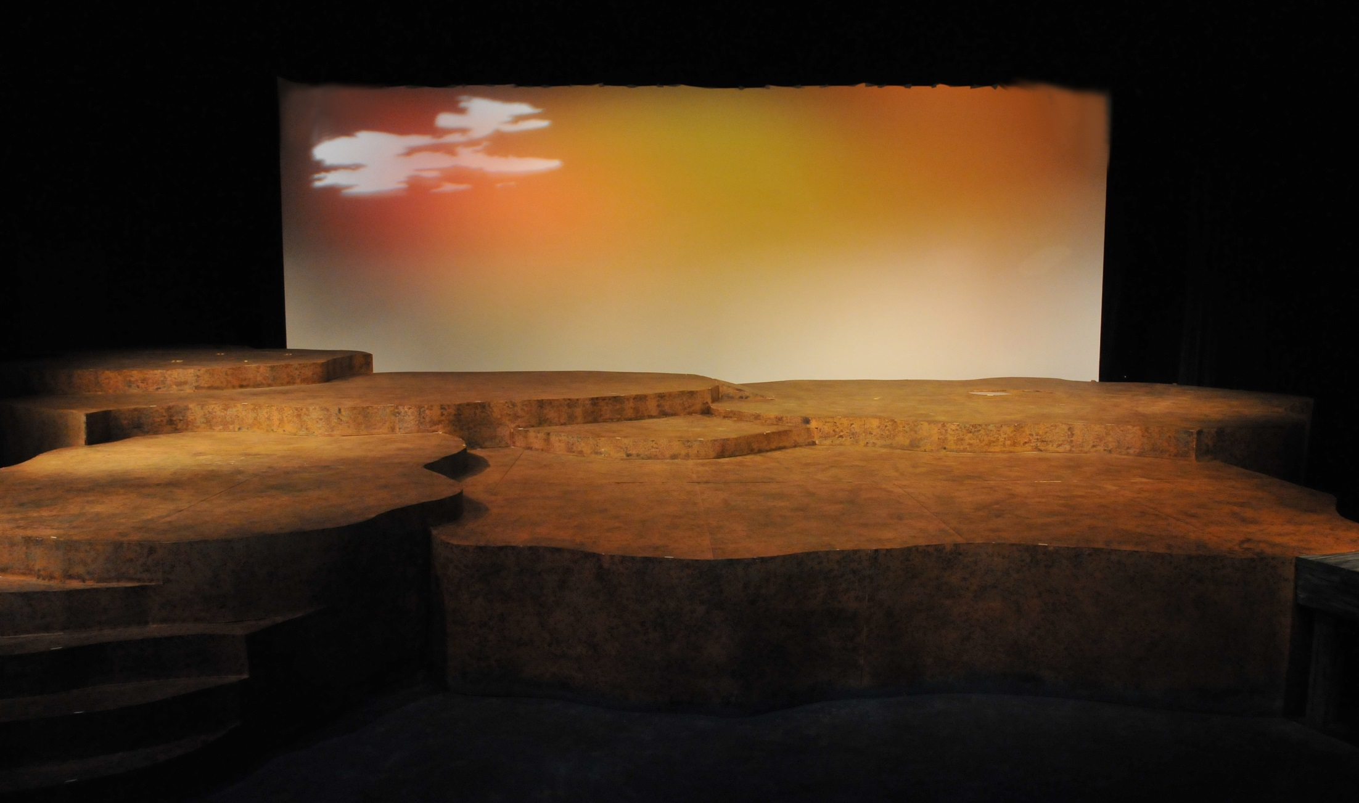
The Diviners – Cloud Gobo

Slide 24
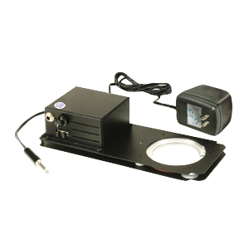


LIGHT ACCESSORIES
WATER GOBO
GOBO ROTATOR
GLASS GOBO

Slide 25
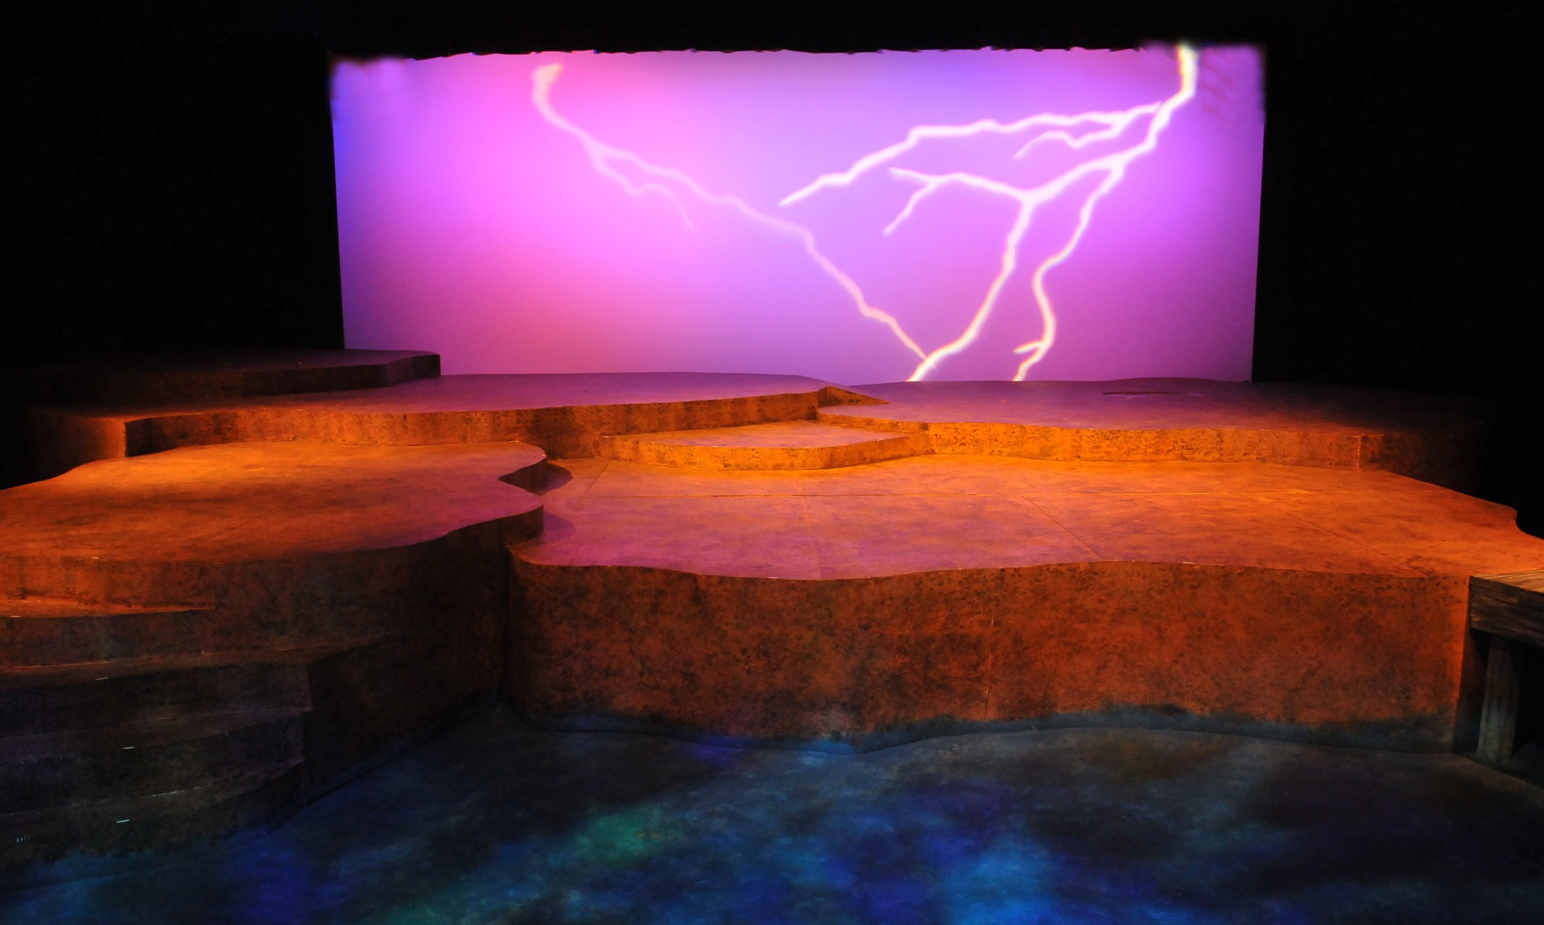
The Diviners – Lightening Gobo &
Water Gobo Rotator

Slide 26
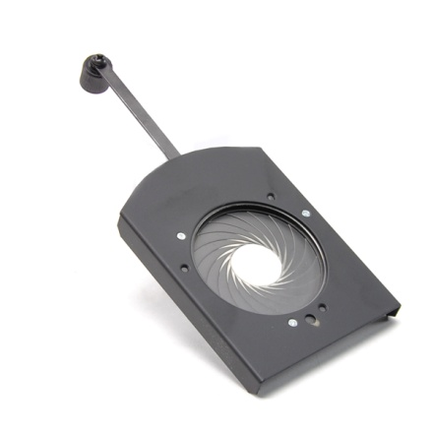
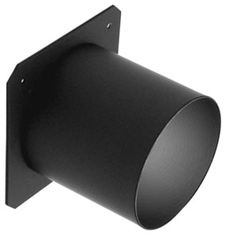
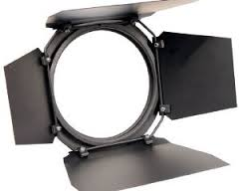
LIGHT ACCESSORIES
TOP HAT
IRIS
BARN DOORS

Slide 27
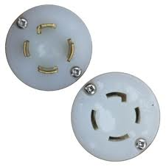
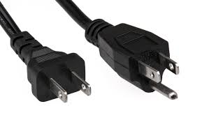
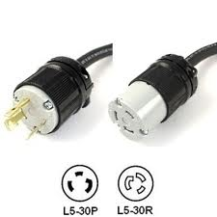
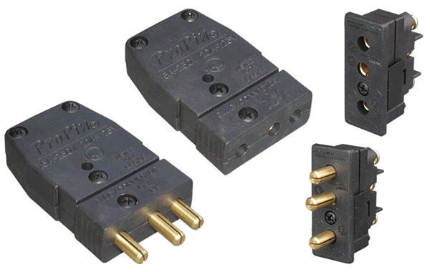
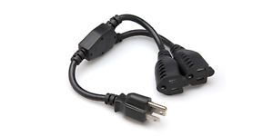
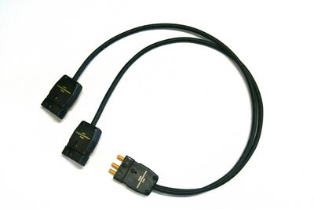
LIGHT PLUGS
EDISON
TWIST LOCK
STAGE PIN
TWO-FER

Slide 28
LIGHT MAINTENANCE
Never run lights at 100%
Running lights at 80% extends life by 2000 hrs
Never touch lamp
Clean lens and glass with rubbing alcohol
Clean shutters with steel wool and graphite powder

Slide 29
LIGHT DESIGN THEORY
“THE MCCANDLESS SYSTEM”
Stanley McCandless “system” of covering a stage with general light.
Does not address specials
Only uses key light
Fill light is added afterwards to fill in shadows or dark area.

Slide 30
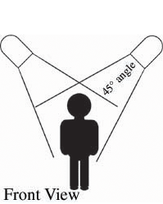
LIGHT DESIGN THEORY
“THE MCCANDLESS SYSTEM”
Each acting area is lit by two lights, each from a position 45 degrees above and to from the center of that area (front lights).
Why? to place feature enhancing shadows on the actor and to draw the actor away from the background.
Ellipsoidals are ideal for front lighting.

Slide 31
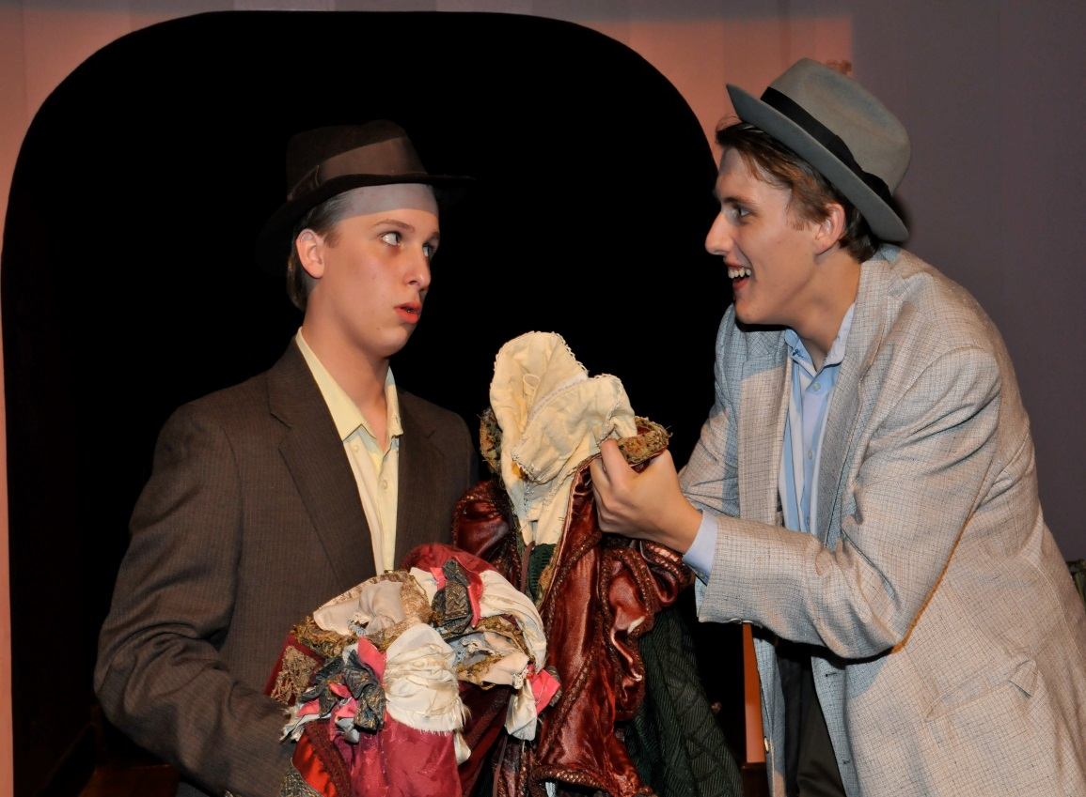
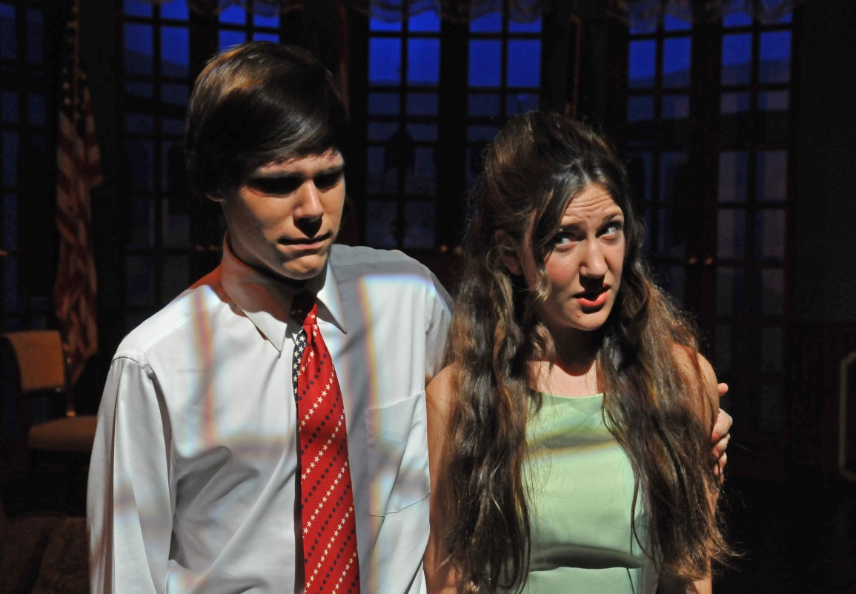
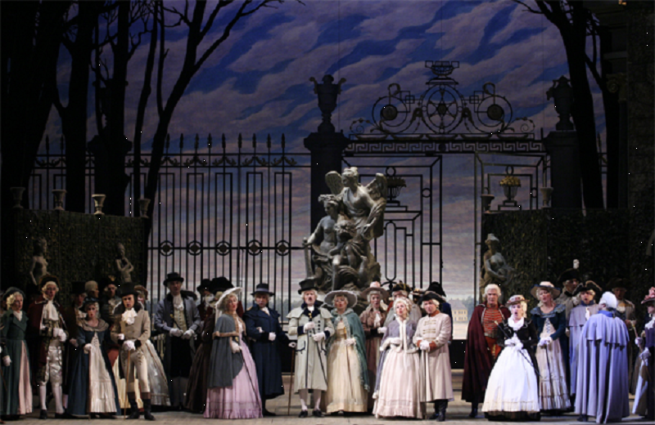
LIGHT DESIGN THEORY
“THE MCCANDLESS SYSTEM”
Example of Front light
Leading Ladies
Don’t Drink The Water

Slide 32
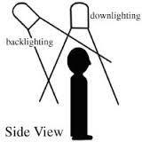
LIGHT DESIGN THEORY
“THE MCCANDLESS SYSTEM”
To separate the actor from the background and provide a 3-dimensional appearance, down lighting and backlighting are important.
Unless trying to achieve a special effect, this type of lighting is not as bright as the front lighting.
Fresnels or PAR cans are ideal to use for backlighting.

Slide 33
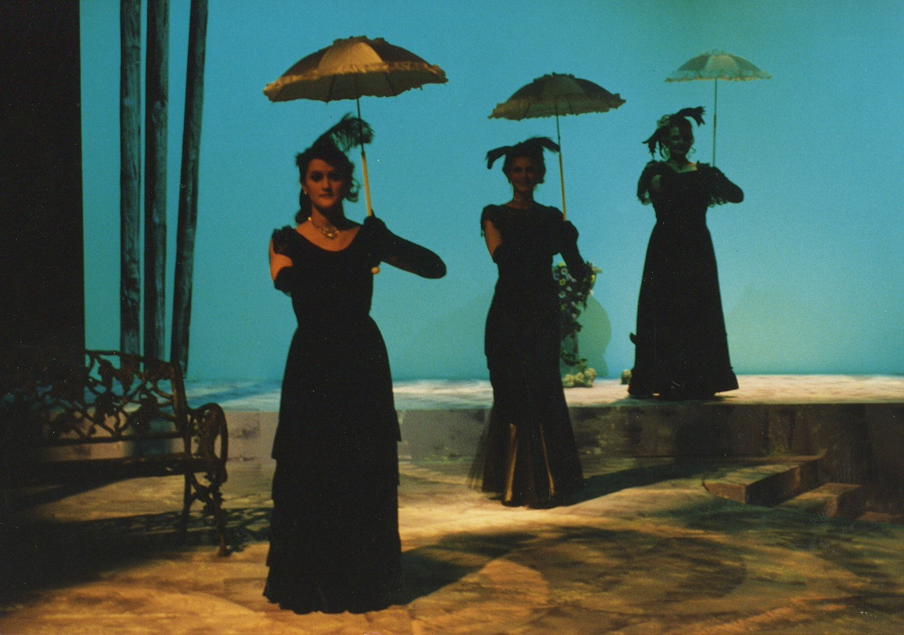
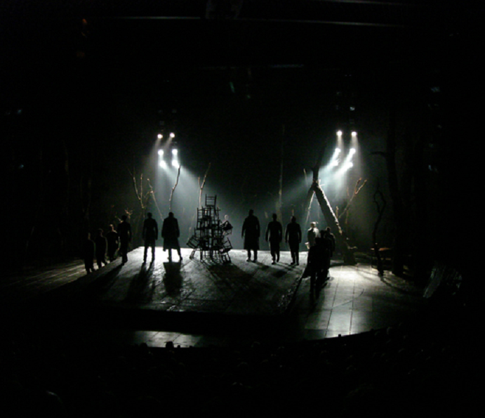
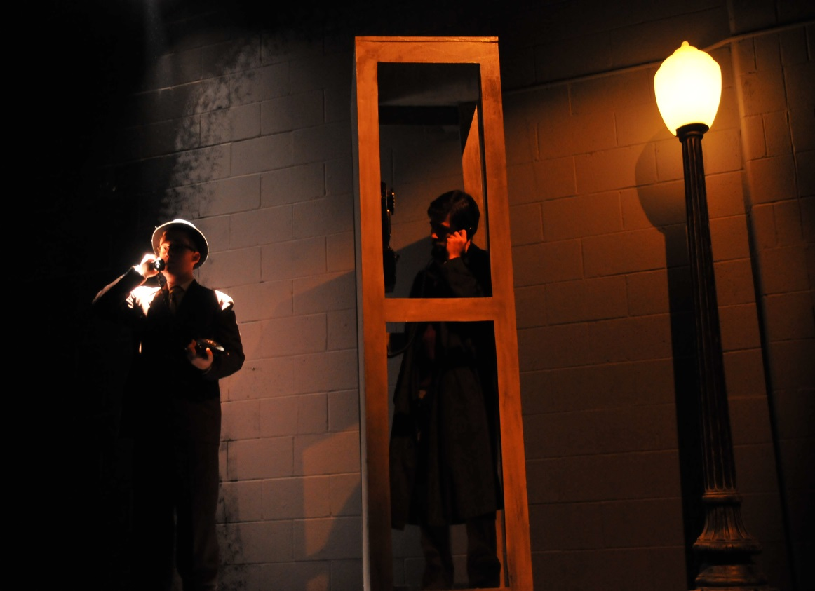
LIGHT DESIGN THEORY
A Little Night Music
“THE MCCANDLESS SYSTEM”
Example of Backlight
Wait Until Dark

Slide 34
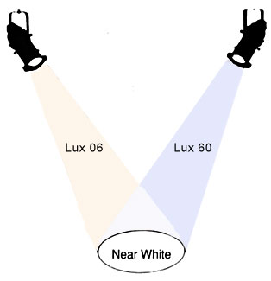
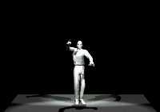
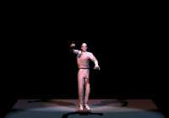
LIGHT DESIGN THEORY
USING COLOR
warm: bastard amber;
neutral: surprise pink;
cool: pale blue

Slide 35
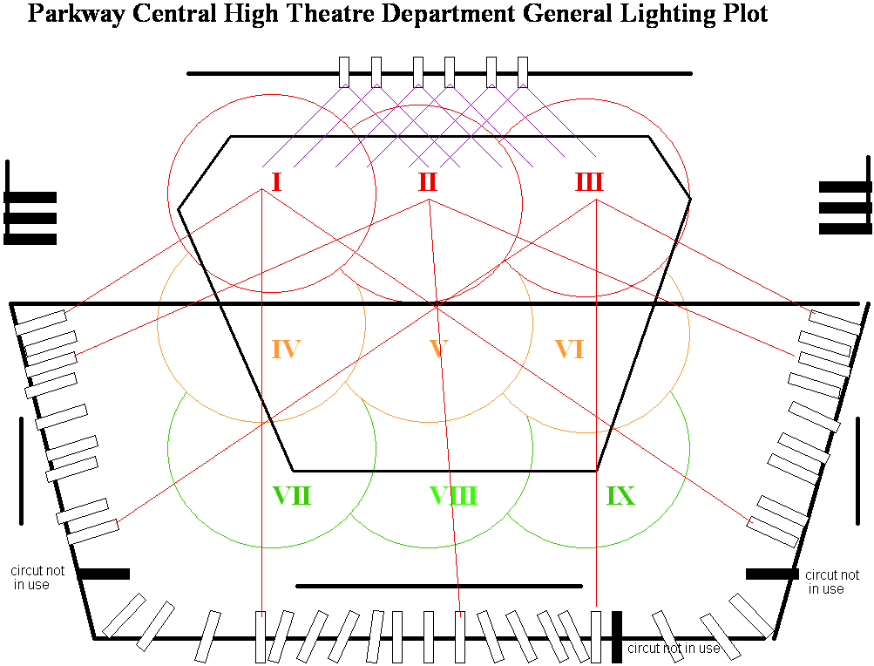
LIGHT PLOT areas 1-2-3

Slide 36
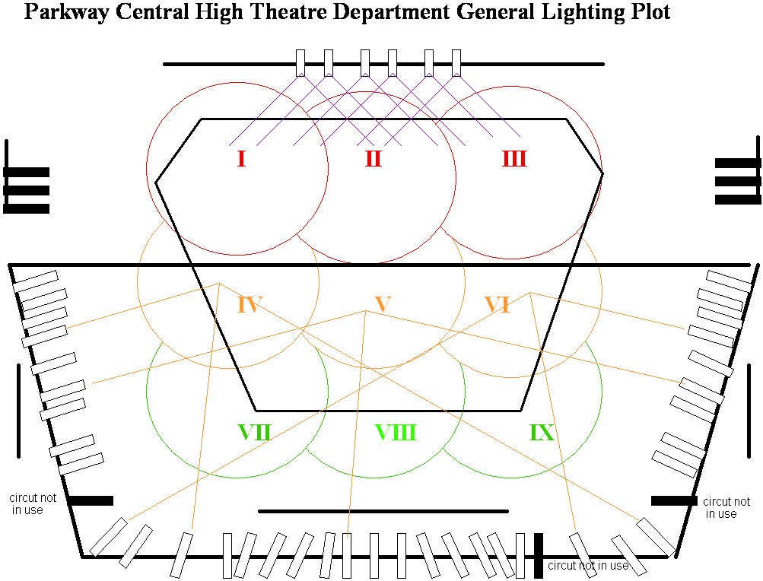
LIGHT PLOT areas 4-5-6

Slide 37
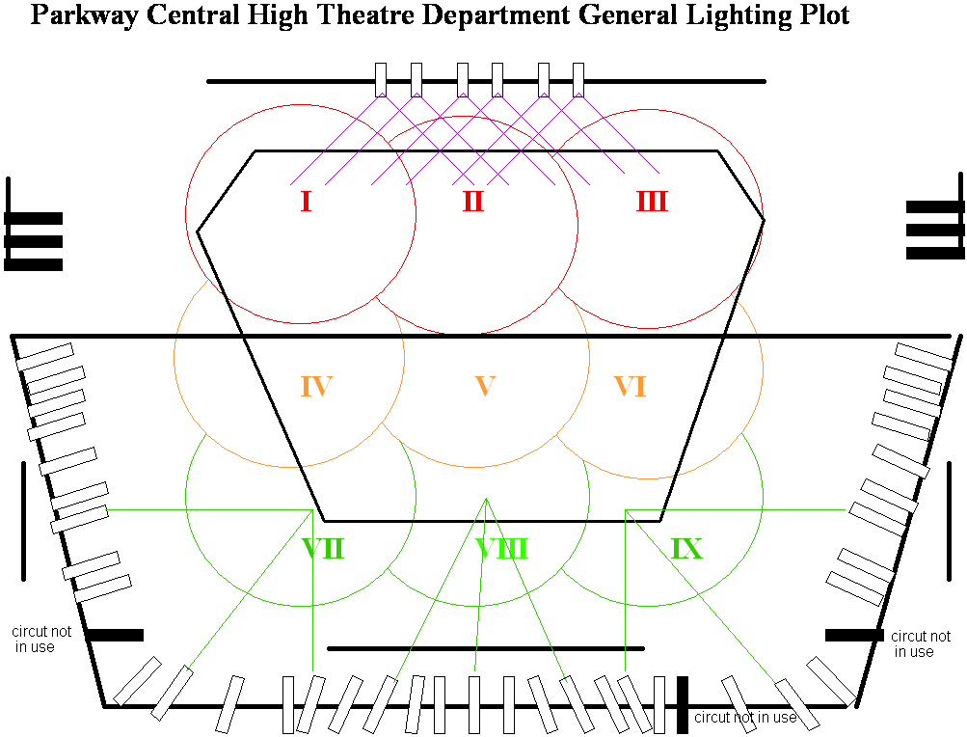
LIGHT PLOT areas 7-8-9

Slide 38
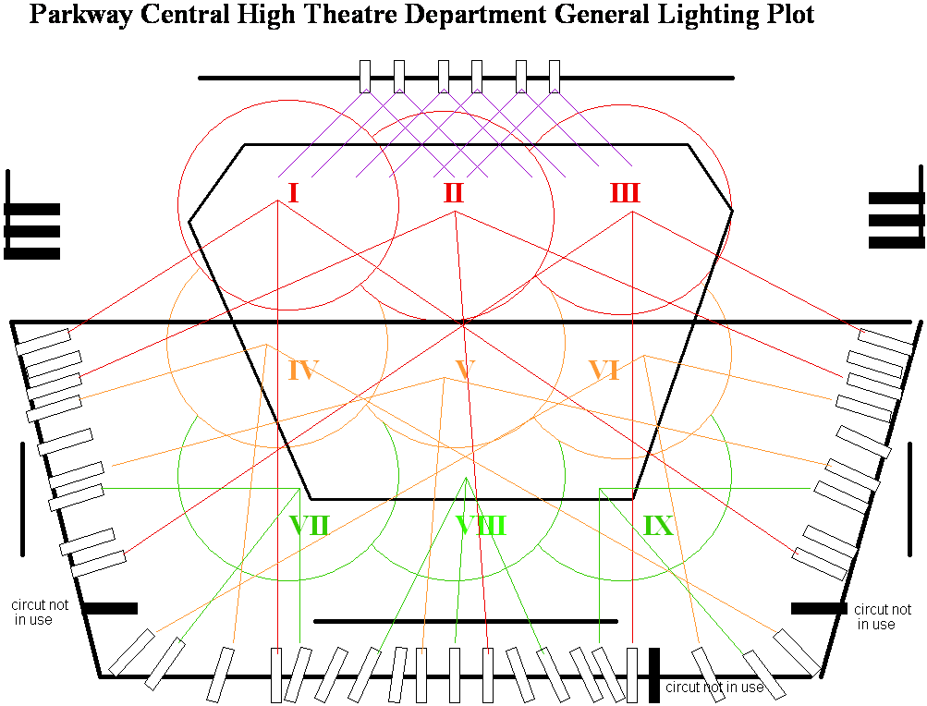
LIGHT PLOT all areas

Slide 39
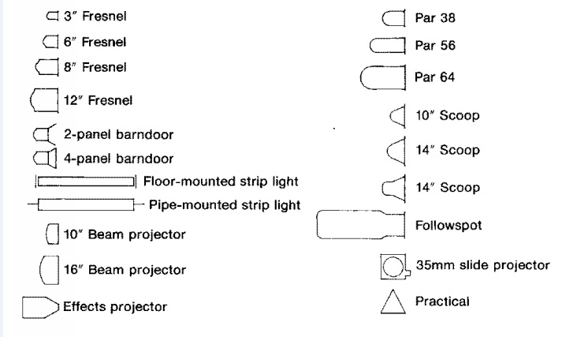
LIGHT FIXTURE SYMBOLS

Slide 40

LIGHT PLOT EXAMPLE

Slide 41

LIGHT PLOT- the elephant man

Slide 42

The elephant man
Although its missing some information, what is there, corresponds with the light fixtures on the light plot.
This sheet allows space for specific details about each light, where there is not room on the light plot.

Slide 43

INSTRUMENT SCHEDULE
A detail list of light fixtures noting where they hang, what area they light and special notes:
  Gel colors
  accessories
Should correspond with the light plot
Instr.#-------- Circuit# | Instrument | Batten | Area | Gel Color | Accessories/notes
1-1 | S4-19 | A | IV | R01 | iris
2-2 | Fr 10” | A | X | R27 | Shutter DR
3-3 | S4-50 | B | XI | R52 | none

Slide 44

LIGHT PRODUCTION
LIGHT DESIGNER
  Light Research
  Light Notes
MASTER ELECTRICIAN
  Light Plot
  Instrument Schedule
LIGHT CREW
  Hang lights off plot & I.S.
BOARD OPERATOR
  Light cue sheet
Wicked - Lighting
http://youtu.be/QUKDU3r6MYY
Billy Elliot – “Lights the Lights”
http://youtu.be/spG3J4ODJSQ
Spiderman-Light Design
http://youtu.be/k4FinZS274I

